Slide 1
Multi-Agent Reinforcement Learning via Knowledge Transfer with Differential Noise and Relevance Weights
Authors: Zishuo Cheng, Dayong Ye, Tianqing Zhu, Wanlei Zhou, Philip Yu
Submitted to IJCAI 2019

Slide 2
Overview
Introduction
Challenges & Contributions
Method
Experiments
Conclusion

Slide 3
Introduction
Multi-agent reinforcement learning (MRL) is a learning process that enables multiple participants to learn appropriate behaviours in an interactive environment.
One of the essential aspects in MRL is to improve the learning performance.

Slide 4
Introduction
Transfer learning (TL) is one of the popular methods to speed up MRL algorithms by using the samples collected from the source to train the agents in the environment.
Transfer learning is a research problem in machine learning that focuses on storing knowledge gained while solving one problem and applying it to a different but related problem.

Slide 5
Challenges
However, the existing methods consider the problem in a more ideal condition. Thus, there are three challenges for the existing methods when applying TL to MRL to solve a realistic problem:
Environment complexity
Size of sample set
Negative transfer

Slide 6
Challenge 1 - Environment Complexity
The existing methods apply TL to MRL in a fully observable environment with a MDP model(S, A, P, R).
However, a real-world environment can be much more complex, such as partially observable condition.

Slide 7
Challenge 2 - Size of Sample Set
The existing methods assume that samples has been pre-collected before transfer learning. One of the main works for most existing methods is to identify the similarity between samples and target and then to define the transfer method.
However, for most real-world environments, especially an unknown environment, the samples are rare and difficult to be pre-collected.

Slide 8
Challenge 3 - Negative Transfer
Negative transfer is a critical challenge for all the transfer learning methods, which is the interference of the previous knowledge with new learning tasks, where one set of events could hurt performance on related tasks.
Numerous existing methods attempt to improve the robustness of negative transfer, and adding relevance weights is one of the effective ways.
However, in a complex environment, adding relevance weight is still not enough to reduce the interference of negative transfer.

Slide 9
Contributions
To overcome these three challenges, we proposed a novel TL method for MRL, called differential knowledge transfer with relevance weights (denoted as DTW). It has the features as follows:
Our method is applicable in a partially observable environment.
Our method transfers knowledge simultaneously in MRL algorithm, which means that it does not require to pre-collect samples.
Our method is robust to negative transfer even in a complex environment.

Slide 10
Method
Feature ONE: Partially observable environment
To solve the problem of partially observation, DTW adopts a Partially Observable Markov Decision Process (POMDP).
The main difference between MDP and POMDP:
In POMDP, when an agent takes an action, it receives an observation instead of moving to a state.

Slide 11
Method
Feature TWO: Sample size
In our domain, agents learn and transfer knowledge between each other simultaneously.
Tirinzoni et al. 2018 ICML:
This paper proposed a weighting method in TL. However, it assumes that the samples have been well trained in other models and pre-collected.
DTW proposed a TL model in an online manner.

Slide 12
Method
Feature THREE: Robustness of negative transfer
DTW jointly uses differential noise and relevance weights to improve the robustness to transfer.
Randomisation Property of DP:
Differential privacy is a privacy model that guarantees that an individual record being stored in or removed from a dataset will make little difference to the an analytical output of the dataset.

Slide 13
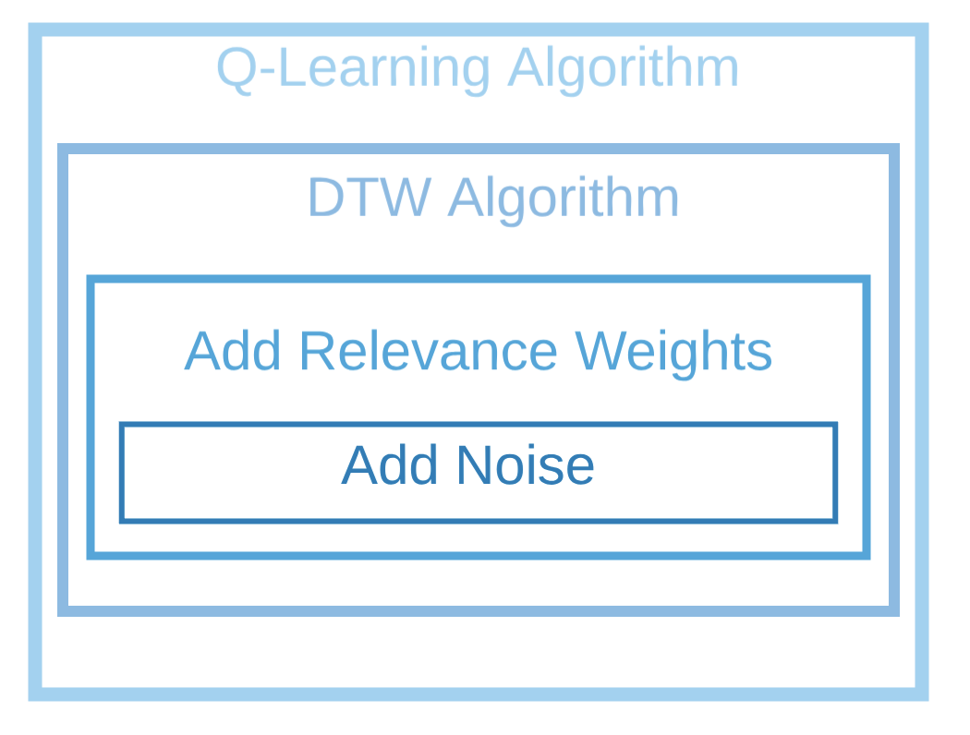
Method

Slide 14
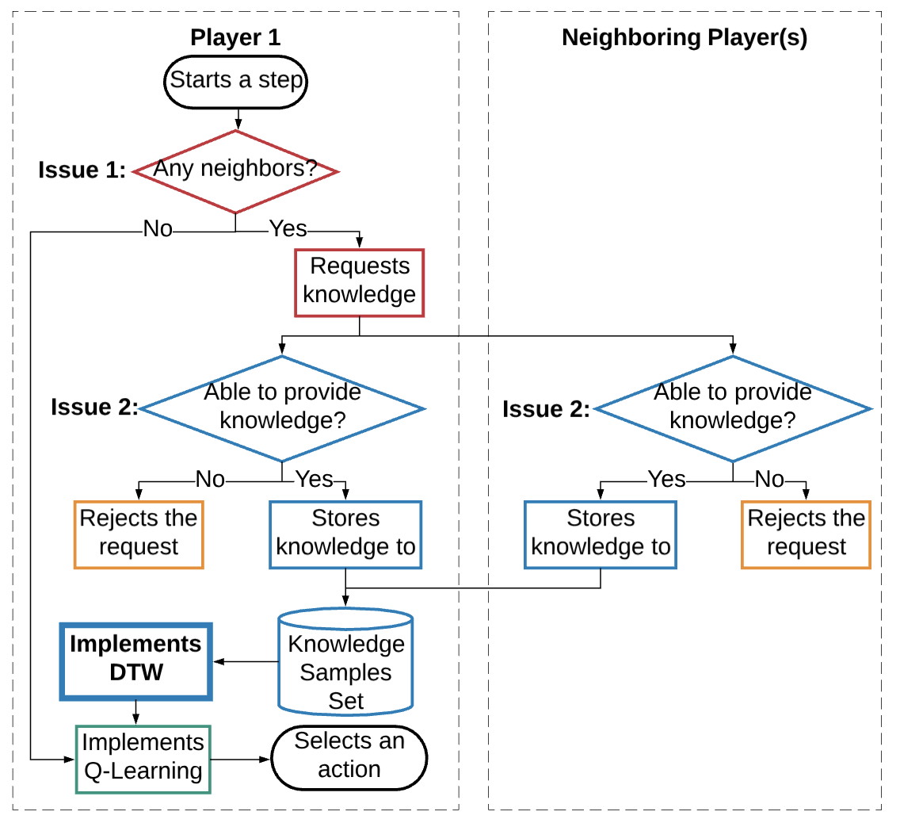
Method

Slide 15
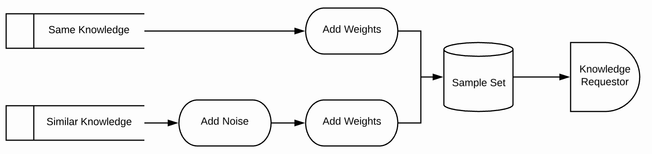
Method

Slide 16
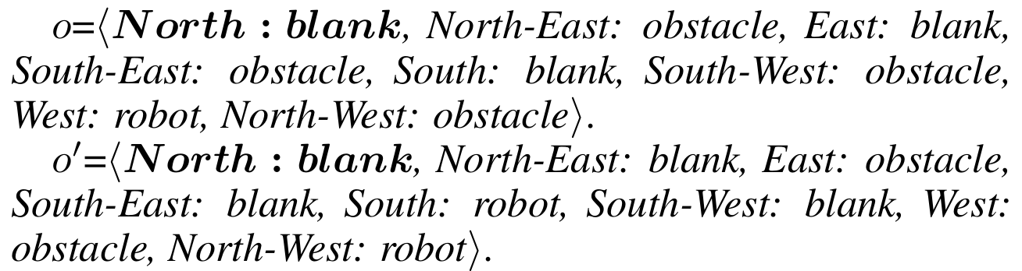
Method
The similarity between o and o’ is ⅛.

Slide 17
Method
Relevance Weights is calculated regarding the similarity and experience.
Noise is produced from an exponential mechanism.

Slide 18
Experiments
Two experimental domains:
Rubbish Cleaning: a domain contains a fixed amount of rubbish and obstacles in fixed positions;
Victim Rescuing: a domain contains a fixed amount of obstacles in fixed positions and a fixed number of victims moving dynamically.
Two domain sizes:
18x12 grids: 4 agents, 40 goals, 25 obstacles
24x16 grids: 6 agents, 60 goals, 45 obstacles

Slide 19
Experiments
Compared DTW with four benchmark methods:
Random – Without Learning Capability
Multi-agent Reinforcement Learning (MRL) – Basic MRL
Transfer Learning (TL) – Basic Knowledge Transfer
Transfer with Relevance Weights (TW) – Without Differential Noise

Slide 20
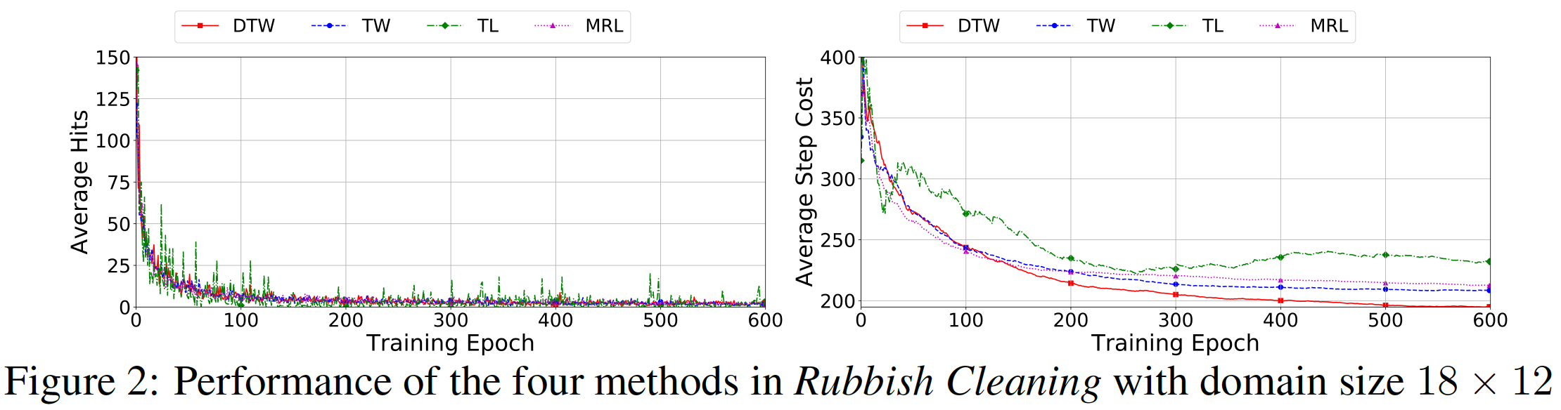
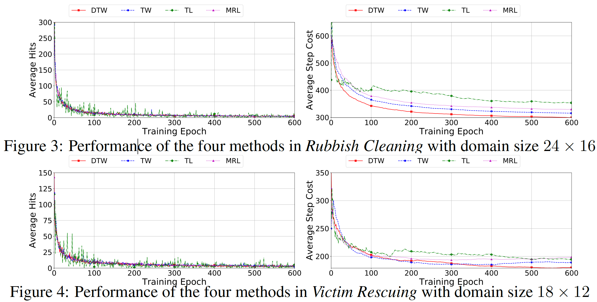
Experiments
TW was 2%~4.5% fewer than MRL and 40%~54% fewer than Random.
DTW was 8.5% ~9.5% fewer than MRL and 44% ~56% fewer than Random.
DTW also costed 5% fewer steps than TW.

Slide 21
Conclusion
To our knowledge, this method is the first to jointly apply differential noise and relevance weights to knowledge transfer among multiple players in a partially-observable environment.
Compared to existing methods, DTW enables to not only augment the sample sizes but also further improve the robustness of negative transfer.

